Slide 1

Image Captioning Model: Bridging Vision and Language
This presentation explores our image captioning model that bridges computer vision and natural language processing. We'll cover key benefits, technical strengths, applications, and future improvements.

Slide 2
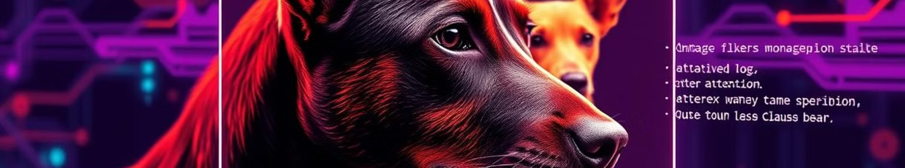




Key Benefits
Bridging Vision and Language
Transfer Learning Efficiency
Model "understands" visual content via pretrained CNNs and translates it into coherent text descriptions.
Uses pretrained image models to extract features. Saves computational resources.
Contextual Awareness
Scalability
Bidirectional LSTMs and attention layers focus on relevant image parts while generating captions.
Supports batch processing for handling large datasets efficiently.

Slide 3








Technical Strengths
Hybrid Architecture
CNN image encoder + LSTM text decoder with attention
Robust Training
Callbacks prevent overfitting; Adam optimizer balances speed and accuracy
Text Preprocessing
Tokenization and padding standardize captions for batch processing
Feature Storage
Saves extracted features and tokenizers for fast inference

Slide 4

Real-World Applications
Accessibility
Generates alt-text for images, aiding visually impaired users.
Content Creation
Automatically tag/caption social media posts or e-commerce products.
Search Optimization
Improves image searchability using descriptive captions.
Education/Research
Helps study cross-modal (vision-language) AI understanding.

Slide 5
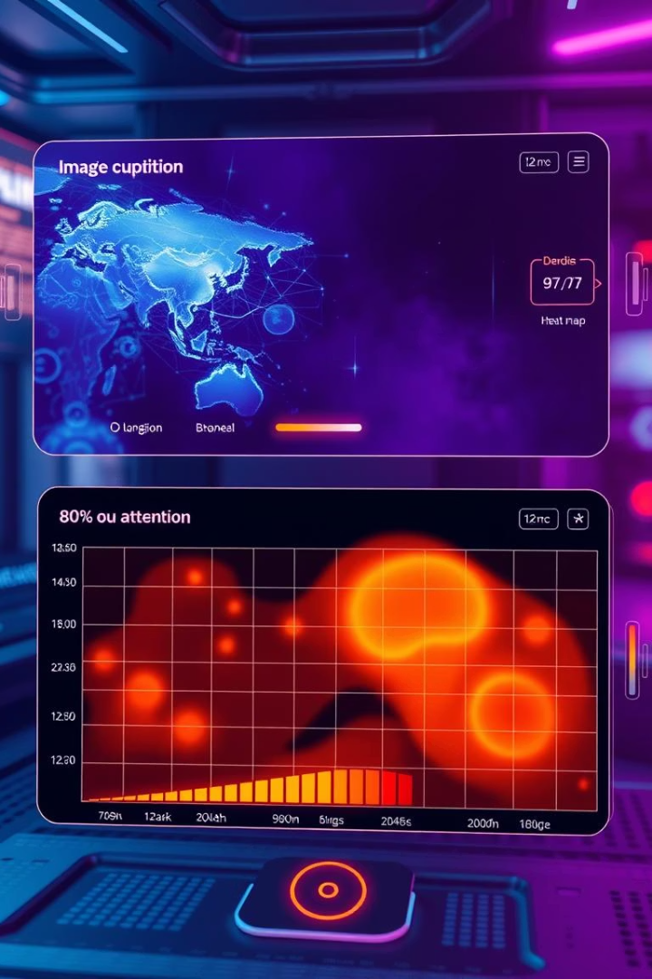




Future Improvements
Beam Search
Replace greedy decoding for more diverse captions.
Transformer Models
Use ViT + GPT architectures for better performance.
Attention Visualization
Show which image regions influenced specific words.
Multilingual Support
Extend to generate captions in Arabic, Spanish, etc.

Slide 7

Image Captioning System Overview
This presentation covers key components of an advanced image captioning system.
You'll learn about data processing, model design, training, inference, and GUI integration.

Slide 8
Image Feature Extraction
Caching
Feature Vector
Pretrained Model
Features saved for reuse to speed up training cycles.
Extracts 2048-dimensional vectors from the penultimate layer.
InceptionV3 pretrained on ImageNet without final classification layer.

Slide 9
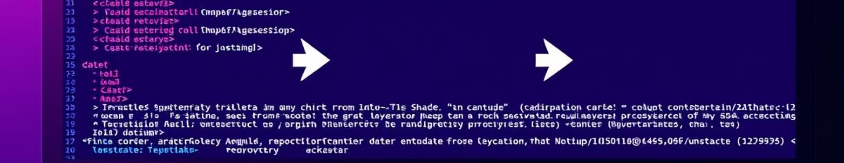
Text Preprocessing
Caption Loading
Cleaning
Sequence Tokens
Map captions to image IDs for alignment.
Lowercase, remove punctuation, tokenize with RegexpTokenizer.
Add implicit startseq and endseq tokens to each caption.

Slide 10

Vocabulary Building
Tokenizer Creation
Use Keras tokenizer to create word index from cleaned captions.
Token Saving
Persist tokenizer using pickle for consistent reuse.

Slide 11



Custom Data Generator
Targets
2
Produces next word predictions as targets for training.
Inputs
1
Generates batches of image features and partial sequences.
Sequence Handling
Manages padding and truncation to max sequence length.
3

Slide 12




Model Architecture
Image Path
Text Path
Fusion & Output
Features → Dense layer → Dropout for regularization
Word sequences → Embedding → LSTM → Dropout
Combine paths via Add() → Dense → Softmax over vocabulary

Slide 13

Training and Inference
1
Training
Uses generator-based batches, Adam optimizer, sparse categorical loss.
2
Inference
Predicts captions word-by-word until end token or max length.
3
Quality Boost
Removes repetitive words to improve caption readability.

Slide 14




Graphical User Interface (GUI)
Image Upload
Caption Display
Aesthetic Design
Users can upload any image for captioning.
Shows generated caption alongside the image.
Blurred background enhances visual appeal.

Slide 16

Character-Level Neural Machine Translation Using Seq2Seq LSTM
This presentation covers the design and implementation of a character-level neural machine translation system based on sequence-to-sequence learning with Long Short-Term Memory (LSTM) networks in Keras. The model translates sentences from a source language like English to a target language such as Arabic. We explore data processing, model architecture, training strategies, and inference methodology essential for efficient and accurate translation.

Slide 17
Data Pipeline and Character-Level Preprocessing
Preprocessing Steps
Dataset Structure
Lines are split into source and target text. Target sentences are annotated with start-of-sequence (\\t) and end-of-sequence (\\n) tokens. Unique characters from both texts form the vocabularies. Each character is indexed for numerical conversion, facilitating one-hot encoding. Sequences are padded to uniform length to accommodate batch processing.
The dataset consists of sentence pairs separated by a tab character. Each line contains a source sentence and its corresponding target translated sentence. An optional third field is ignored. A total of 10,000 sample sentence pairs are used to control computational complexity.

Slide 18

Character-Level Modeling Advantages
Reduced Vocabulary Size
Handling Rare or Out-of-Vocabulary Words
Modeling at the character level lowers the vocabulary size drastically compared to word-level models, making training on limited data more feasible and computationally efficient.
Character-level approaches effectively deal with rare, unseen, or misspelled words by breaking them into basic units, ensuring better generalization on novel inputs.
Simplified Tokenization
Eliminates complex tokenization schemes necessary for word-level processing, enabling uniform treatment of languages with varying morphology or script characteristics.

Slide 19
Model Architecture: Encoder and Decoder Design
Decoder
Encoder
Initialized with encoder states, the decoder LSTM outputs one character at a time. A dense softmax layer predicts the next output character probabilistically. This sequential character generation enables flexible sentence translation.
Processes one-hot encoded input character sequences using an LSTM layer. It outputs two internal state vectors: hidden state and cell state, which summarize input context for the decoder.

Slide 20
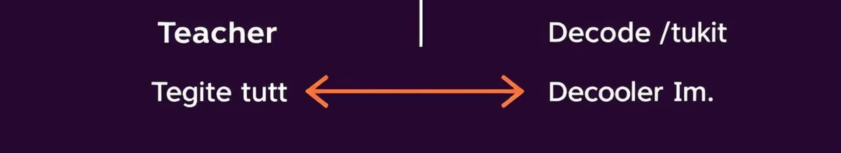
Training Strategies and Teacher Forcing
Teacher Forcing
Optimization and Validation
Model Persistence
During training, the decoder receives the actual previous target character rather than its own prediction. This accelerates learning and stabilizes training by providing a ground truth context for every step.
Upon completion, the trained model is saved in Keras format to facilitate later inference and deployment without retraining.
The model uses RMSprop optimizer with categorical crossentropy loss. Training spans 100 epochs, batch size 64, and applies 20% validation split to monitor performance on unseen data.

Slide 21
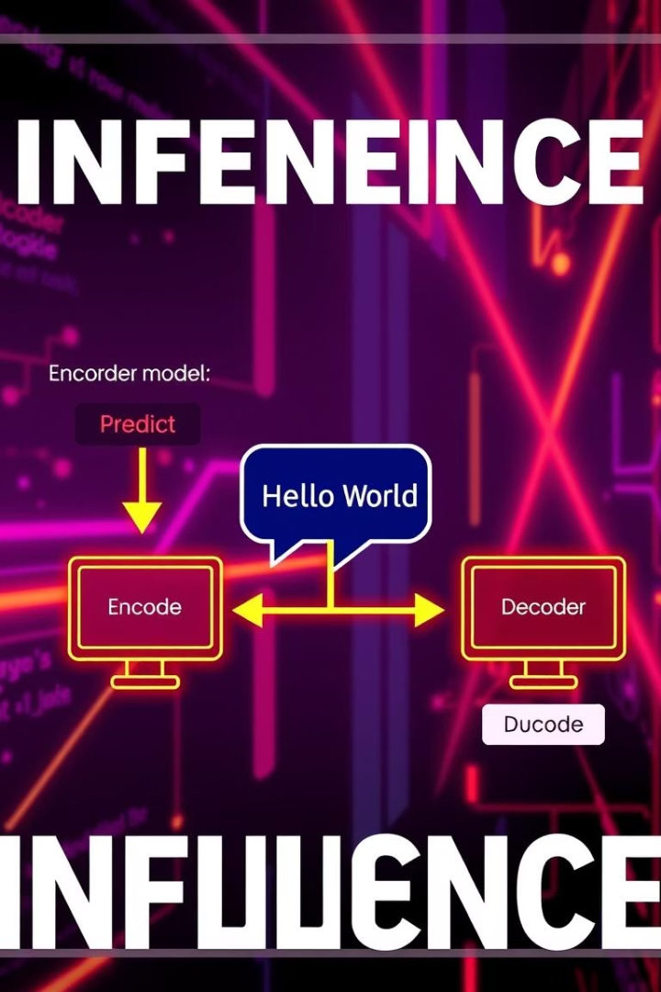


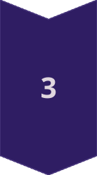
Inference and Greedy Decoding Process
Encoder Model
Encodes input sentence into internal states representing context vectors.
Decoder Initialization
Uses encoder states to set initial decoder state before generating output sequence.
Character-by-Character Generation
The decoder predicts the next character with the highest probability (greedy decoding), feeding predictions back as input for subsequent steps until end-of-sequence token.

Slide 22
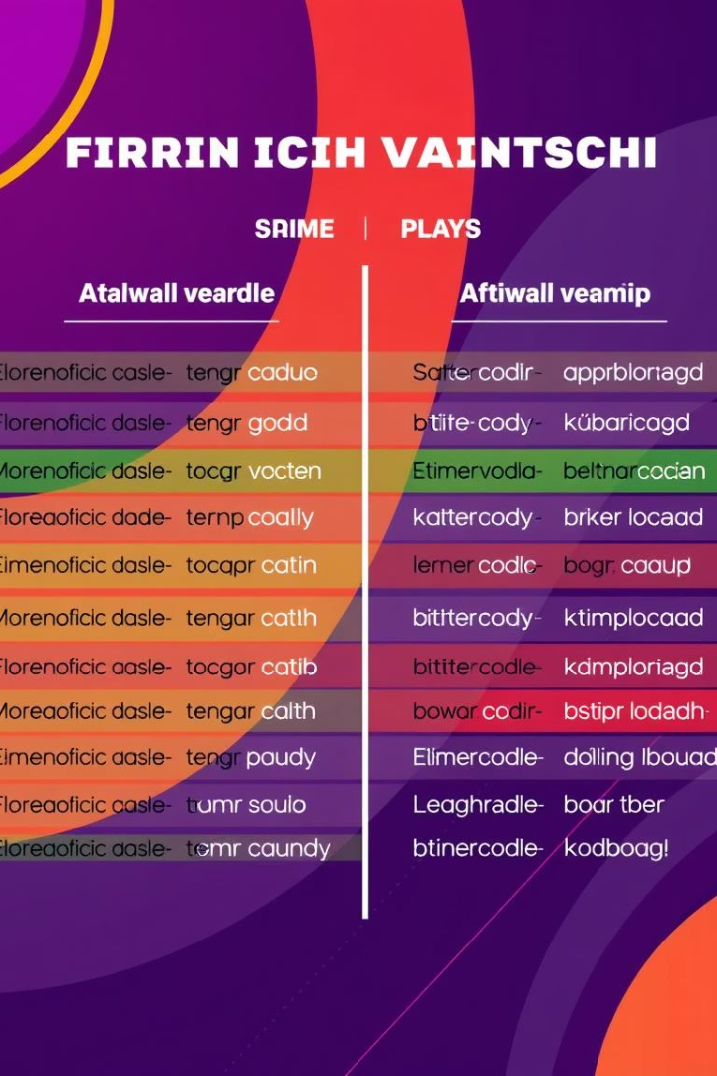
Evaluation and Qualitative Assessment
Sample Generation
20 input sentences from the training data are used to generate translations, allowing performance observation on both seen and slightly varied inputs.
Qualitative Analysis
Translation outputs are examined against source sentences for linguistic accuracy, fluency, and preservation of meaning, measuring the model’s practical applicability.
Insights and Limitations
While character-level modeling excels in fine-grained control, some challenges remain in capturing long-range dependencies and contextual nuances in complex sentence structures.

Slide 23

Technical Summary and Workflow
6
100
10000
Core Workflow Steps
Epochs for Training
Training Samples
1. Load and preprocess parallel character-level data
Extensive training allows the model to learn complex character sequence mappings for accurate translation.
Limited sample size balances computational feasibility and model robustness.
2. Convert to one-hot encoded tensors
3. Define encoder-decoder with LSTM
4. Train with teacher forcing over 100 epochs
5. Save trained model to disk
6. Perform inference with greedy decoding
This comprehensive approach demonstrates how character-level seq2seq models can effectively translate languages by leveraging detailed sequence modeling, optimized training techniques, and modular inference architecture.

